Slide 1

What Is Machine Learning
Professor Bo Liu
James Watt School of Engineering

Slide 2
What is ML?
Machine Learning Definition
“Learning is any process by which a system improves performance from experience.” - Herbert Simon
“The field of study that gives computers the capability to learn without being explicitly programmed”. - Arthur Samuel

Slide 3
Traditional programming vs. ML
Traditional Programming vs. ML
Traditional Programming
Input (Data)
Computation
Output
Program logic
Machine Learning
Training
Implicit program logic (Model)
Training Data
Output
Input

Slide 4
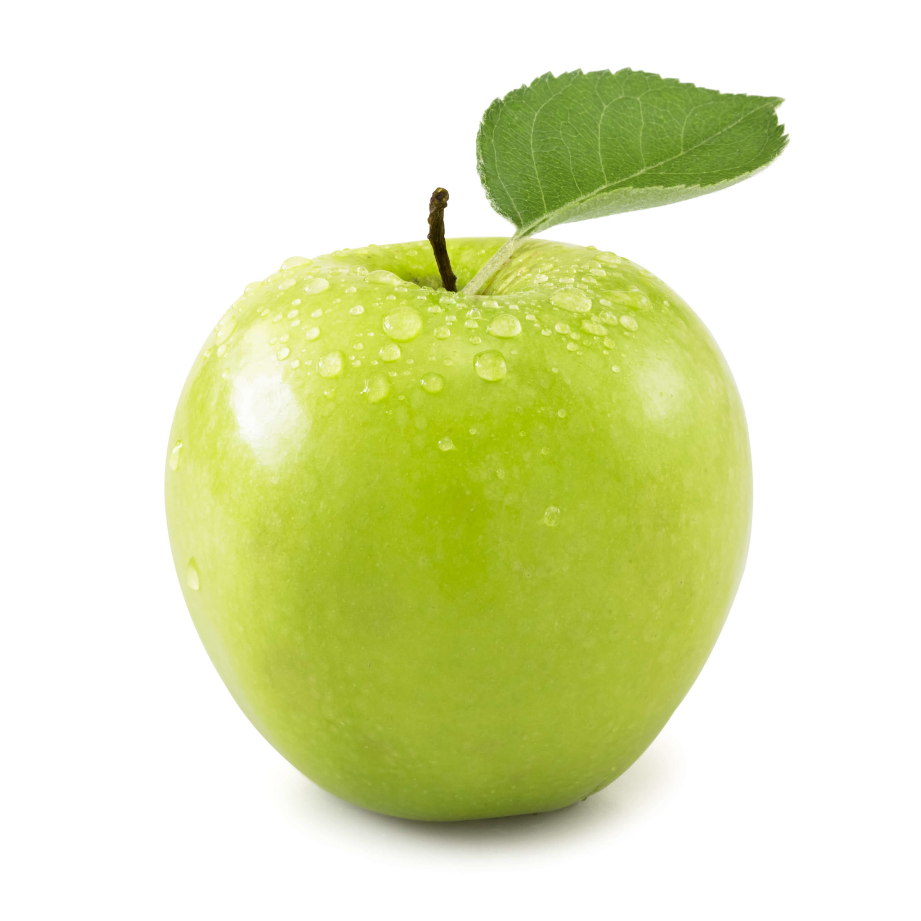
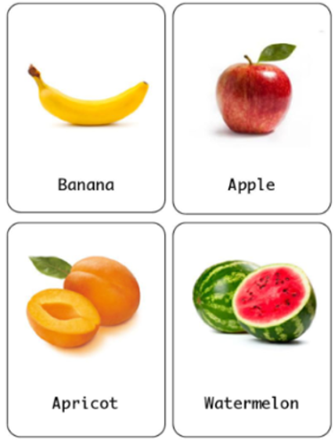
Traditional programming vs. ML: an example
For example, to recognize/classify a fruit,
Traditional programming:
if color == ‘green’
if smell == ‘sweet’
…….
Output apple
else
Output not apple
end
Input
Output
Apple
Not apple
ML:
Training
ML model
Apple
Not apple
Output
Training data

Slide 5
Types of ML
Supervised learning
Given: training data with desired outputs (labels)
Unsupervised learning
Given: dataset without desired labels
Semi-supervised learning
Given: training data with a few desired labels

Slide 6

Types of ML
Supervised Learning
Unsupervised Learning
Semi-Supervised Learning
data
label
data
label
data
label
dog
No label
dog
bird
No label
bird
airplane
No label
No label
deer
No label
No label
cat
No label
No label
truck
No label
No label
ship
No label
No label

Slide 7




Thanks!
#UofGWorldChangers
@UofGlasgow

